Slide 1

NIL Semester Project
By: Marissa Czapla

Slide 2
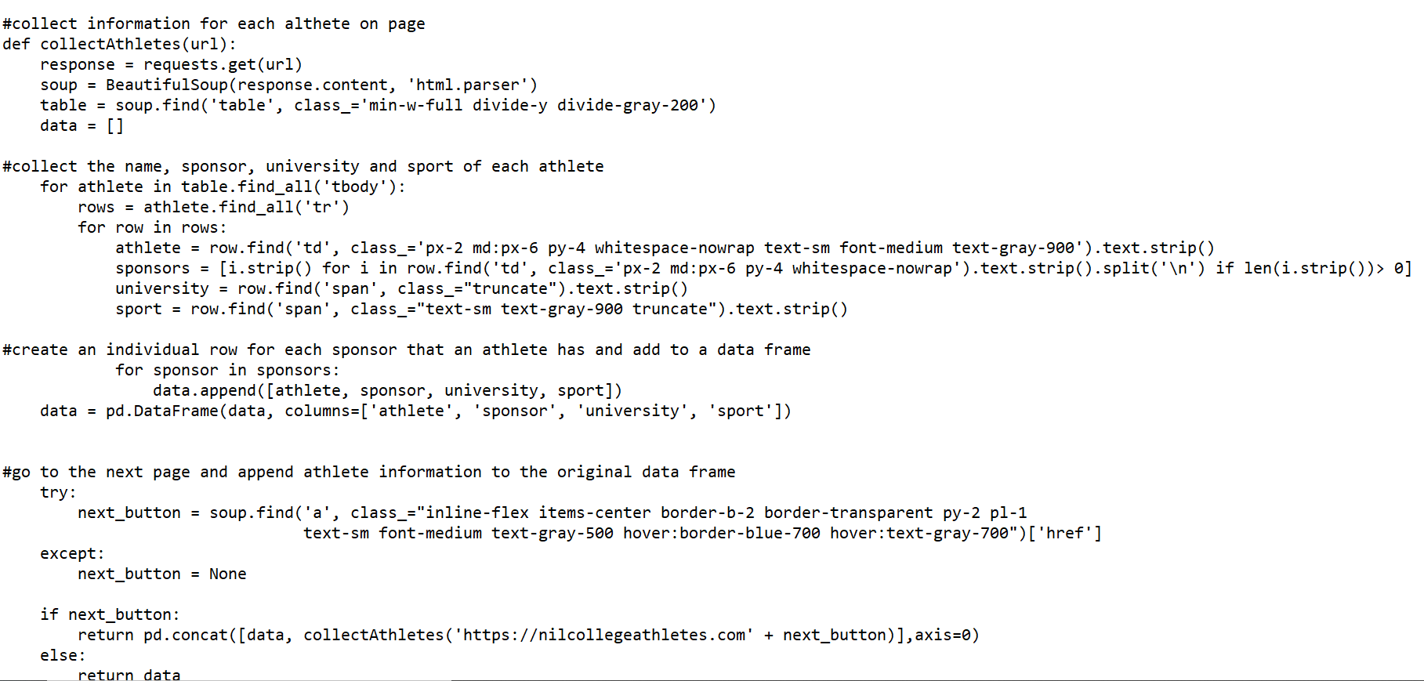
Code:
7697 rows × 4 columns

Slide 3
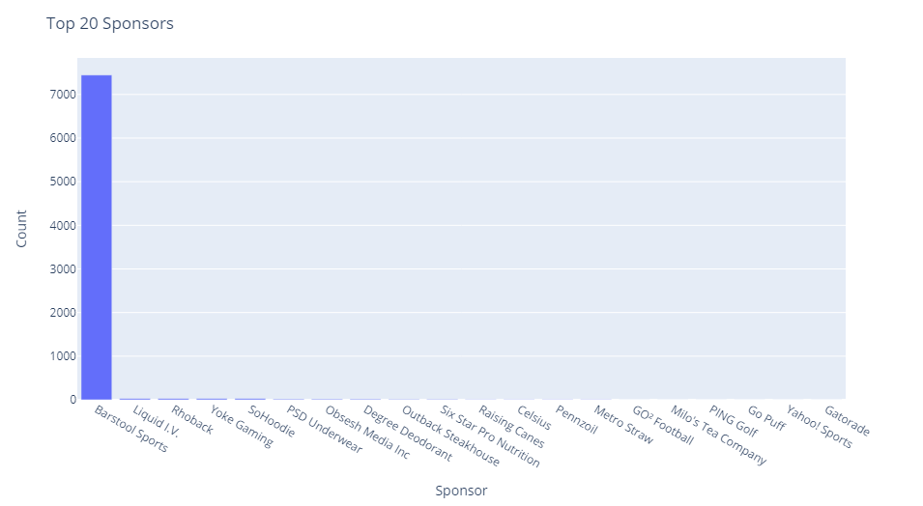

Slide 4
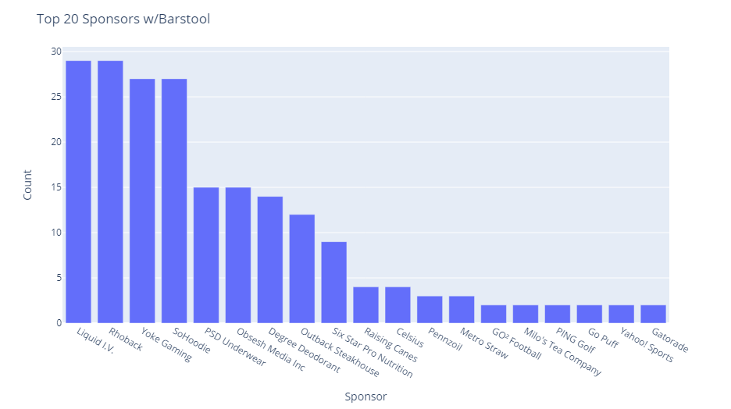

Slide 5
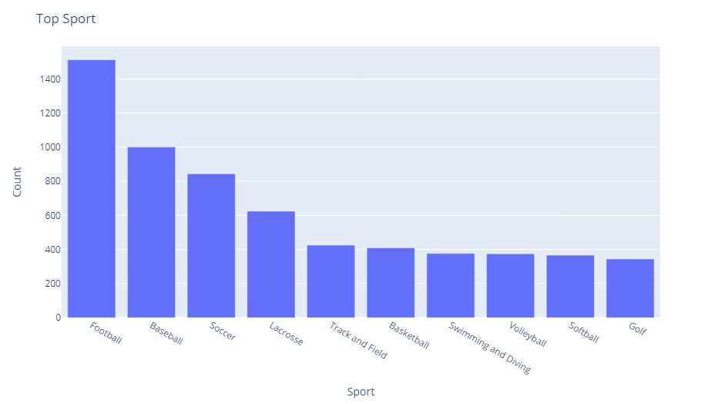

Slide 6
